Slide 1
Session 5: Effective Expenditure of Funds
Charting Our Course: Maximizing VR Resources - Increasing Customer Outcomes
2023 CSAVR Spring Conference

Slide 2
Disclaimer
This content was developed by the VRTAC-QM, a project funded under #H264J200002; the VRTAC-QE, a project funded under #H264K200003; the NTACT:C, a project funded under #H326E200003, of the U.S. Department of Education (Department); and CSAVR, a member organization of State Vocational Rehabilitation Agencies. The information contained herein does not necessarily reflect the position or policies of the Department, and no official endorsement of any non-Federal product, service, or venture should be inferred.

Slide 3
Presenters for today
Chaz Compton, Ed.D., CRC
Project Director, VRTAC-QM
Cayte Anderson, Ph.D., CRC, LPC
QE State Liaison
Emily Brinck, Ph.D., CRC
QE State Liaison
Jessica Holton, MS, CRC, LPC
QE State Liaison
Kathy West-Evans
CSAVR Director of Business Relations
Inger Neal
CSAVR Business Relations Consultant

Slide 4
Effective Expenditure of Funds
Objectives
Examine:
how culture can impede expenditures.
how legacy practices can affect expenditures.
how quick and effective customer engagement contributes to positive outcomes.
Identify underutilized innovative employment strategies and how these can result in improved outcomes and effective expenditures.

Slide 5
The Message
This topic reinforces the message and mission of this conference – effective expenditure of funds maximizes the use of available resources and increases and improves employment outcomes for our participants

Slide 6
Why begin with Culture?
“Culture eats strategy for breakfast.”
- Peter Drucker
No real proof he said this, but it is widely ascribed to him.

Slide 7
What a difference a couple of years can make
Pre-pandemic fiscal positions
OOS
Many years of closely watching the purse strings
And then…
MARCH 12

Slide 8
Old Habits Die Hard
Legacy practices abound.
Spending restrictions, policies and procedures (informal and formal) that cap service amounts or deny them outright.
Multiple layers of approval.
Think of your units, districts, regions or areas and how the personalities of leadership and direct service staff impacts expenditures.
It is difficult to change this behavior and takes a concerted ongoing effort and consistent message.

Slide 9
Why Rapid Engagement?
The numbers indicate we need to engage people sooner and more effectively in order to maximize their chance of success.
A brief review of the numbers.
65-70% exit unsuccessfully after application.
Of that group, more than 70-75% exit for one of the big three reasons, all of which are in some way related to lack of engagement
Speed to eligibility, plan, and services make a difference.

Slide 10
Speed to eligibility and outcomes PY 2020
Duration | % Rehabilitated (n) | % Other than Rehabilitated (n)
0-5 days | 39.0% (19483) | 61.0% (30412)
6-15 days | 36.8% (17548) | 63.2% (30197)
16-30 days | 35.9% (19558) | 64.1% (34975)
31-45 days | 33.4% (16423) | 66.6% (32767)
46-60 days | 30.0% (22017) | 70.0% (51439)
61-90 days | 31.5% (6084) | 68.5% (13257)
Over 90 days | 29.6% (5879) | 70.4% (13966)

Slide 11
Speed to plan on outcomes PY 2020
Duration | % Rehabilitated (n) | % Other than Rehabilitated (n)
One day or less | 48.9% (3755) | 51.1% (3923)
2 to 30 days | 50.2% (20334) | 49.8% (20190)
31 to 60 days | 46.7% (20982) | 53.3% (23959)
61 to 90 days | 42.0% (19130) | 58.0% (26371)
91 to 150 days | 37.5% (25816) | 62.5% (43082)
151 days or more | 36.7% (16975) | 63.3% (29276)

Slide 12
What Inhibits Rapid Engagement?
A disclaimer on capacity.
The IPE is more of a delaying factor than eligibility.
For eligibility, the process can be rooted in pre-1992 amendments, reminiscent of the medical model.
A need to help our counselors exercise their professional interviewing skills and judgment.
For the IPE - the fear of writing an incomplete or bad IPE.

Slide 13
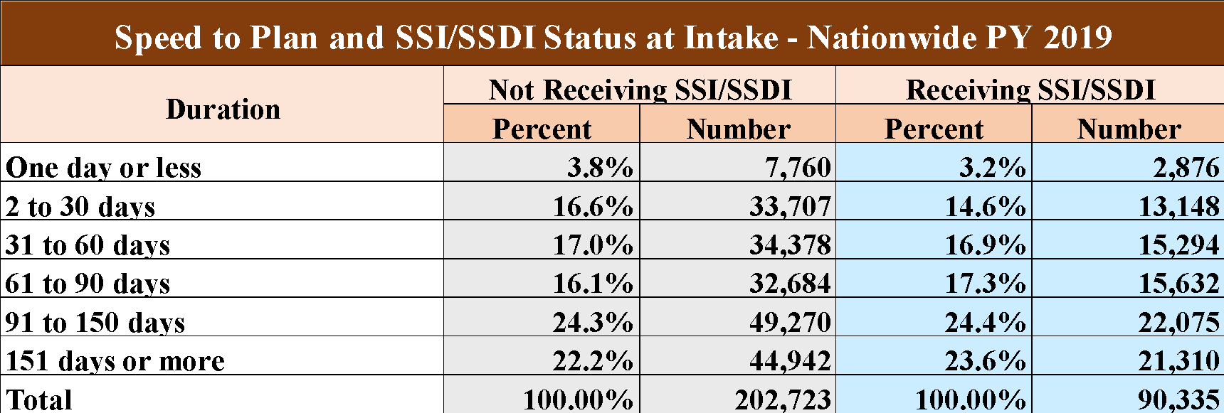
A Look at SSA Beneficiaries

Slide 14
How can we move the needle?
Honestly examine our culture.
Examine our policies and procedures, identify the delaying areas, and make changes.
Articulate your commitment to rapid engagement in your policies –
An example of a simple policy change – From a policy of determining eligibility within 60 days, to determining eligibility as soon as possible, but no later than 60 days.

Slide 15
How can we move the needle? (2)
We must train our staff to conceptualize the IPE as a living document that can be amended – it doesn’t have to be perfect to get going.
An examination of how we do business, why we do what we do, why we wait, and its impact is essential.

Slide 16
Effective Expenditure of Funds Utilizing Innovative Employment Strategies
VRTAC-QE

Slide 17
Defining ‘Quality Employment’
Career development opportunities
Higher wages
(Chan et al., 2016)
(Chan et al., 2016)
Increased hours
Employer benefits
Notes:
Cayte

Slide 18
Evidence-Based Strategies That Promote Long-Term and High-Quality Employment
Apprenticeships (Brockman & Smith, 2023; Lester & Bravenboer, 2020; Sack & Allen, 2019)
Business (Employer) Engagement (Briggs et al., 2019; Tamburo et al., 2019; Van Berkel, 2021)
Career Pathways (Bragg, 2019; Peck et al., 2021; Sama & Adam, 2020)
Internships (Garcia-Casarejos & Sáez-Pérez, 2020, Stewart, 2021)
Notes:
Emily

Slide 19
Evidence-Based Strategies That Promote Long-Term and High-Quality Employment (2)
Rapid Engagement (Cohen et al., 2020; Noel et al., 2018; Swanson et al., 2020)
Targeted Outreach (Mamun et al., 2019; Patnaik et al., 2022)
Work-Incentives Benefits Counseling (Delin et al., 2012; Hartman et al., 2015; Iwanaga et al., 2021; Schlegelmilch et al. 2019)
Work-Based Learning Experiences (Luecking & Luecking, 2013; Mazzotti et al., 2012; Stodden et al., 2001)
Notes:
Emily

Slide 20
VRTAC-QE Training and TA Topics
Apprenticeship / Pre-apprenticeship
Career Counseling
Career Pathways
Community Coordination
Customized Employment
Customized Training Programs
Disaster Preparedness
Employer Engagement
Employer Support Strategies
Health and Disability
Internships
Job Accommodation
Local labor market analysis
Motivational Interviewing
On-the-Job Training
Outreach to Diverse Populations
or Communities
Pre-Employment Transition Services
Rapid Engagement
Self-Employment
Subminimum Wage Waivers
Reductions
Supported Employment
Telecommuting
Transportation
Veterans and Veterans
Administration Outreach
Work Incentive Benefits Counseling
Work-based Learning Experiences
Notes:
Cayte

Slide 21
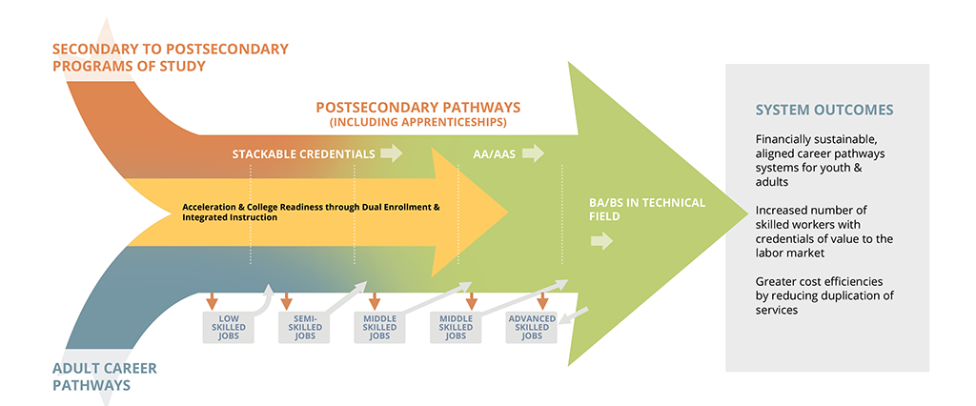
Career Pathways
https://cte.ed.gov/initiatives/career-pathways-systems
Notes:
Jessica
Notes:
‘Career Pathways’ is different method of case conceptualization rather than a specific “service”. It shifts the narrative from helping consumers get and keep jobs, and instead focuses on improving longer-term employment outcomes consistent with the quality indicators. Another way to think about this is that helping individuals identify, pursue, and successfully achieve career goals in high demand occupations with opportunities for growth is an investment in their future economic well-being.
Successful efforts to integrate career and technical education programs of study with Career Pathways Systems requires a commitment from multiple partners working together toward greater transparency, alignment, and systemic change. The Integrated Career Pathways Model shows how a comprehensive Career Pathways System can serve both high school age youth, as well as adults, and promote collaboration, alignment, and cross-system development of structured pathways into and through postsecondary credential programs.

Slide 22
Career Pathways Models Inherently Include:
Apprenticeships
Business Engagement
i.e., customized, "non-traditional" training(s)
Internships
Post-secondary Training and Education
Notes:
Cayte

Slide 23
Registered Apprenticeship (RA) Technical Assistance “Big Highlights”
What we’ve learned (SVRA needs):
Opportunity to increase SVRA knowledge of RAs
Many SVRAs are not (or are just starting) to work with their State Offices of Apprenticeship (OA)
SVRA Business Services Units must get involved to work jointly with State OA:
to develop RA employer sites
to clarify qualifications for RA positions & suitable candidates
to establish referral process
Notes:
Cayte
Apprenticeship efforts are led by our QE partners through the University of Illinois at Urbana Champaign (UIUC)
OJT and other related demand-side or needs of employer may benefit PWD, they may not be utilized by a majority of business. Small businesses (under 500 employees) employ about half of the nation’s workforce (Small business admin, 2018, as cited in Sepulveda, 2021) these business often hire people with limited to no work experience, and offer part-time positions. Suitable for PWD with limited work experience or who require part-time (Bruyere, 2006, as cited in Sepulveda, 2021).
191 articles, were deduced to 13 and examined based on pieces of research considered to be demand-side articles or focused on employer perspectives. Costs was the most prevalent theme, followed by Knowledge of ADA; policy and practice least in terms of barriers identified based on review of this included research.
Costs- larger the company, the more money they are willing to spend on accommodations. Smaller and medium-sized businesses are more concerned about costs such as health care, insurance premiums, workers compensation claims, and cost of accommodations. Also, fear of litigation, loss of productivity, extra time spent on training and supervising employees with disabilities are additional barriers to employment of PWD.
Stereotype/stigma- less favorable or more negative attitudes are held by smaller to mid-size businesses than larger organizations. Attitudes included: PWD being perceived as weak, or perceived as unable to perform the job, limited job skills and qualifications, and having poor job histories. Hospitality employers indicate safety and productivity issues are concerns, but interestingly they are less concerned than larger businesses regarding customer reactions to employees with disabilities. In addition, employers may be more reluctant to hire people with certain types of disabilities. For example, employers may be more concerned about hiring people who are blind or with psychiatric disabilities than hiring people with hearing, speech or developmental disabilities.
Employer policies/practices- larger businesses (more than 500 employees) are more likely to recruit and hire, provide accessibility and accommodations, conduct disability trainings for staff, and retain and promote persons with disabilities than companies with fewer employees. In another study, smaller companies were less likely to be committed to recruiting individuals with disabilities and less likely to have written diversity-related policies than larger companies. However, small to mid-size business who hired youth with disabilities were more committed to providing opportunities for youth with disabilities and giving back to the community than larger businesses.
ADA/Disability Legislation- For employers w/more than 25 employees who are required to provide reasonable accommodation in areas of access to structures, application and interview processes, and reasonable accommodations. In this area, the research indicates that small to mid-size managers had little knowledge of the ADA and recruiting resources. Smaller companies were also less supportive of ADA legislation, less likely to implement accommodations, or have formal disability policies. They were also found to hire people with disabilities less, know about or use incentive programs for hiring PWD, and are less familiar with issues related to interviewing and application accommodations.
Engagement with VR Services- For this theme based on the analysis, larger companies were more likely to use disability service agencies, than smaller ones. Smaller companies suggested they would be willing to hire a qualified PWD but none ever applied, and they did not know of agencies who could assist with recruitment. Some smaller organizations were also dissatisfied with rehabilitation service providers, and indicated that employment specialists were unable to answer questions about their role or were mainly concerned about quick placement and not the needs of the business.
Sepulveda, T. (2021). Barriers to hiring and accommodating people with disabilities in small and medium sized businesses: A scoping review. Journal of Applied Rehabilitation Counseling, 52(2), 104-114.

Slide 24
Registered Apprenticeship (RA) Technical Assistance “Big Highlights” (2)
To address these needs, QE is:
Training SVRA to prepare VR customers for RAs (counselor toolkit)
Conducting Needs Assessments to identify SVRA RA training needs
Providing joint SVRA/OA/UIUC RA presentations to employers and staff
Helping OA & SVRA develop RA grant announcement
Providing RA and Youth Apprenticeship Webinars to national VRTAC-QE registered audience
Facilitating Apprenticeship Learning Community
Notes:
Cayte
Apprenticeship efforts are led by our QE partners through the University of Illinois at Urbana Champaign (UIUC)
OJT and other related demand-side or needs of employer may benefit PWD, they may not be utilized by a majority of business. Small businesses (under 500 employees) employ about half of the nation’s workforce (Small business admin, 2018, as cited in Sepulveda, 2021) these business often hire people with limited to no work experience, and offer part-time positions. Suitable for PWD with limited work experience or who require part-time (Bruyere, 2006, as cited in Sepulveda, 2021).
191 articles, were deduced to 13 and examined based on pieces of research considered to be demand-side articles or focused on employer perspectives. Costs was the most prevalent theme, followed by Knowledge of ADA; policy and practice least in terms of barriers identified based on review of this included research.
Costs- larger the company, the more money they are willing to spend on accommodations. Smaller and medium-sized businesses are more concerned about costs such as health care, insurance premiums, workers compensation claims, and cost of accommodations. Also, fear of litigation, loss of productivity, extra time spent on training and supervising employees with disabilities are additional barriers to employment of PWD.
Stereotype/stigma- less favorable or more negative attitudes are held by smaller to mid-size businesses than larger organizations. Attitudes included: PWD being perceived as weak, or perceived as unable to perform the job, limited job skills and qualifications, and having poor job histories. Hospitality employers indicate safety and productivity issues are concerns, but interestingly they are less concerned than larger businesses regarding customer reactions to employees with disabilities. In addition, employers may be more reluctant to hire people with certain types of disabilities. For example, employers may be more concerned about hiring people who are blind or with psychiatric disabilities than hiring people with hearing, speech or developmental disabilities.
Employer policies/practices- larger businesses (more than 500 employees) are more likely to recruit and hire, provide accessibility and accommodations, conduct disability trainings for staff, and retain and promote persons with disabilities than companies with fewer employees. In another study, smaller companies were less likely to be committed to recruiting individuals with disabilities and less likely to have written diversity-related policies than larger companies. However, small to mid-size business who hired youth with disabilities were more committed to providing opportunities for youth with disabilities and giving back to the community than larger businesses.
ADA/Disability Legislation- For employers w/more than 25 employees who are required to provide reasonable accommodation in areas of access to structures, application and interview processes, and reasonable accommodations. In this area, the research indicates that small to mid-size managers had little knowledge of the ADA and recruiting resources. Smaller companies were also less supportive of ADA legislation, less likely to implement accommodations, or have formal disability policies. They were also found to hire people with disabilities less, know about or use incentive programs for hiring PWD, and are less familiar with issues related to interviewing and application accommodations.
Engagement with VR Services- For this theme based on the analysis, larger companies were more likely to use disability service agencies, than smaller ones. Smaller companies suggested they would be willing to hire a qualified PWD but none ever applied, and they did not know of agencies who could assist with recruitment. Some smaller organizations were also dissatisfied with rehabilitation service providers, and indicated that employment specialists were unable to answer questions about their role or were mainly concerned about quick placement and not the needs of the business.
Sepulveda, T. (2021). Barriers to hiring and accommodating people with disabilities in small and medium sized businesses: A scoping review. Journal of Applied Rehabilitation Counseling, 52(2), 104-114.

Slide 25
Business Engagement: Why and How
What drove Legislative changes?
What does that mean to VR staffing, resources and outcomes?
Dual customers – invest in the relationships: “Working smarter not harder.”
Expanding career opportunities for VR candidates: “Begin with the end in mind.”
Staff training, building business team inside a VR agency. Business Unit, AT, OT, VRCs, training centers, other key staff.
Collaboration across systems.

Slide 26
Action Steps
Follow-up Action Steps
The VR agency will increase allowable expenditures on innovative employment strategies that promote quality employment outcomes including (a) training consistent with measurable skills gains and credential attainment, (b) apprenticeships, (c) targeted outreach, (d) work-incentives benefits counseling, (e) internships, (f) work-based learning, and other Career Pathways strategies including business engagement.
Results An increase in allowable expenditures in key areas and in the number of MOUs and/or agreements with key stakeholders that promote the identified employment practices and strategies.
Follow-up Action Steps
The VR agency will examine their policies, procedures and practices related to allowable service expenditures and customer engagement to determine if they are unnecessarily restrictive and if they delay determinations of eligibility and/or IPE development and revise these accordingly.
Results An increase in allowable expenditures and an increase in the speed with which individuals are found eligible and have an IPE developed.

Slide 27
Questions
Please direct questions to your RSA-SMPID state liaison.

Slide 28
References
Bragg, D. D. (2019). An Integrative Framework for Evaluating the Impact of Career Pathways. Career Pathways: From School to Retirement, 15.
Briggs, A., Spievack, N., & Blount, D. (2019). Employer engagement in summer youth employment programs.
Brockmann, M., & Smith, R. (2023). ‘Invested’partnerships as key to high quality apprenticeship programmes as evidenced in on and off the job training. Journal of Education and Work, 1-17.
Cohen, D. A., Klodnick, V. V., Stevens, L., Fagan, M. A., & Spencer, E. S. (2020). Implementing adapted Individual Placement and Support (IPS) supported employment for transition-age youth in Texas. Community mental health journal, 56, 513-523.
Delin, B. S. , Hartman, E. C. , & Sell, C. W. ((2012) ). The impact of work incentive benefits counseling on employment outcomes: Evidence from two return-to-work demonstrations. Journal of Vocational Rehabilitation, 36: , 97–107.
García-Casarejos, N., & Sáez-Pérez, L. A. (2020). Internships for higher education students to promote the local sustainability of rural places. Sustainability, 12(12), 4926.

Slide 29
References (2)
Hartman, E. C. , Anderson, C. A. , Chan, J. , Fried, J. H. , & Lui, J. W. (2015) ). An exploration of work incentive benefits specialist’s experiences. Journal of Applied Rehabilitation Counseling, 46: (3), 25–34.
Hartman, E., Friefeld, R., Brinck, E., Trainor, A., Reinhard, A., Fuller, R., Jones, W., Schlegelmilch, A., & Anderson, C.A. (2021). Demographic and transition service predictors of employment outcomes for youth receiving Supplemental Security Income. Career Development and Transition for Exceptional Individuals, 1-13. https://doi.org/10.1177/2165143420984797
Iwanaga, K., Wehman, P., Brooke, V., Avellone, L., & Taylor, J. (2021). Evaluating the effect of work incentives benefits counseling on employment outcomes of transition-age and young adult Supplemental Security Income recipients with intellectual disabilities: A case control study. Journal of Occupational Rehabilitation, 1-11.
Lester, S., & Bravenboer, D. (2020). Sustainable degree apprenticeships. Centre for Degree Apprenticeships.
Luecking D. M., Luecking R. G. (2013). Translating research into a seamless transition model. Career Development and Transition for Exceptional Individuals, 38, 4–13.

Slide 30
References (3)
Mamun, Arif, Ankita Patnaik, Michael Levere, Gina Livermore, Todd Honeycutt, Jacqueline Kauff, Karen Katz, AnnaMaria McCutcheon, Joseph Mastrianni, and Brittney Gionfriddo. 2019. Promoting Readiness of Minors in SSI (PROMISE) Evaluation: Interim Services and Impact Report. Washington, DC: Mathematica.
Mazzotti V. L., Test D. W., Mustian A. L. (2012). Secondary transition evidence-based practices and predictors: Implications for policy makers. Journal of Disability Policy Studies, 25, 5–18. https://doi.org/10.1177/1044207312460888
Noel, V. A., Oulvey, E., Drake, R. E., Bond, G. R., Carpenter-Song, E. A., & DeAtley, B. (2018). A preliminary evaluation of individual placement and support for youth with developmental and psychiatric disabilities. Journal of Vocational Rehabilitation, 48(2), 249-255.
Patnaik, A., Levere, M., Livermore, G., Mamun, A., & Hemmeter, J. (2021). Promoting Readiness of Minors in Supplemental Security Income (PROMISE): Early Impacts from a Multi-Site Random Assignment Evaluation. Evaluation Review, 45(5), 228-270.
Peck, L., Schwartz, D., & Strawn, J. (2021). A meta-analysis of 46 career pathways impact evaluations.

Slide 31
References (4)
Sack, M., & Allen, L. (2019). Connecting Apprenticeships to the Young People Who Need Them Most: The Role of Community-Based Organizations. Jobs for the Future.
Sarna, M., & Adam, T. (2020). Evidence on Career Pathways Strategies: Highlights from a Scan of the Research. Rockville, MD: Abt Associates.
Schlegelmilch, A., Roskowski, M., Anderson, C., Hartman, E., & Decker-Mauer, H. (2019). The impact of work incentives benefits counseling on employment outcomes of transition-age youth receiving Supplemental Security Income (SSI) benefits. Journal of Vocational Rehabilitation, 51(2), 127-136.
Stewart, A. (2021). The nature and prevalence of internships. In Internships, Employability and the Search for Decent Work Experience (pp. 17-33). Edward Elgar Publishing.
Stodden R. A., Dowrick P., Gilmore S., Galloway L. M. (2001). A review of secondary school factors influencing postschool outcomes for youth with disabilities. National Center for the Study of Postsecondary Educational Supports, University of Hawaii at Manoa.

Slide 32
References (5)
Swanson, Sarah J., Deborah R. Becker, Gary R. Bond, Kimberly E. Reeder, and Marsha L. Ellison. 2020. IPS Supported Employment for Transition Age Youth: Helping Youth with Serious Mental Health Conditions to Access Jobs, Education, and Careers. Worcester, MA: University of Massachusetts Medical School, Department of Psychiatry, Transitions to Adulthood
Tamburo, J., Switzer, E., & Gower, W. S. (2019). Lessons from the Diversity Partners Project: Using knowledge translation to strengthen business engagement strategies and improve employment outcomes for job seekers with disabilities. Journal of Vocational Rehabilitation, 50(3), 291-299.
Van Berkel, R. (2021). Employer engagement in promoting the labour-market participation of jobseekers with disabilities. An employer perspective. Social Policy and Society, 20(4), 533-547.

Slide 33
Conference Partners

Slide 34
Thank You

