Slide 1
Session 2:
Period of Performance:
It’s All about TIME and OBLIGATIONS
Charting Our Course: Maximizing VR Resources - Increasing Customer Outcomes
2023 CSAVR Spring Conference

Slide 2
Disclaimer
This content was developed by the VRTAC-QM, a project funded under #H264J200002; the VRTAC-QE, a project funded under #H264K200003; the NTACT:C, a project funded under #H326E200003, of the U.S. Department of Education (Department); and CSAVR, a member organization of State Vocational Rehabilitation Agencies. The information contained herein does not necessarily reflect the position or policies of the Department, and no official endorsement of any non-Federal product, service, or venture should be inferred.

Slide 3
Meet Your Presenter
Sarah Clardy
VRTAC-QM

Slide 4
The current state of Period of Performance:
Over the past 5 years 30 VR agencies of the 55 monitored have had findings in this area.
It’s the #1 fiscal-related area VR agencies seek technical assistance in.
Department of Education has regulations that MUST be followed.

Slide 5
Period of Performance (1)
Period of Performance establishes the total estimated TIME interval between the start of an initial Federal award and the PLANNED end date, which may include one or more funded portions, or budget periods (2 C.F.R. §200.1).
Budget Periods represent the TIME interval during which recipients are authorized to expend the funds awarded, including any funds carried forward (2 C.F.R. §200.1).

Slide 6
Period of Performance (2)
The Period of Performance may include one budget period or two if the grantee met carryover criteria.

Slide 7
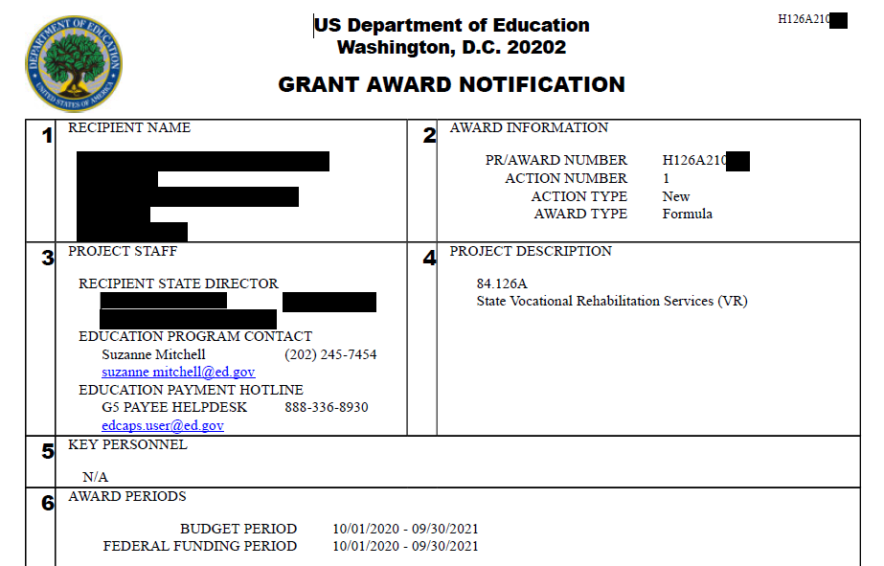
The Department references the Period of Performance as the Federal Funding Period in Box 6 of the GAN.

Slide 8
Now that TIME is established, let’s talk about OBLIGATIONS.
Financial obligations are orders placed for property and services, contracts, and similar transactions that require payment (2 C.F.R. §200.1).

Slide 9
Obligations (1)
The Education Department General Administrative Regulations (EDGAR) gives specific instructions for assigning obligations within the Period of Performance according to the following categories (34 C.F.R. §76.707).

Slide 10
Obligations Table
If the obligation is for - | The obligation is made -
(a) Acquisition of real or personal property | On the date on which the State or subgrantee makes a binding written commitment to acquire the property.
(b) Personal services by an employee of the State or subgrantee | When the services are performed.
(c) Personal services by a contractor who is not an employee of the State or subgrantee | On the date on which the State or subgrantee makes a binding written commitment to obtain the services.
(d) Performance of work other than personal services | On the date on which the State or subgrantee makes a binding written commitment to obtain the work.
(e) Public utility services | When the State or subgrantee receives the services.
(f) Travel | When the travel is taken.
(g) Rental of real or personal property | When the State or subgrantee uses the property.
(h) A pre-agreement cost that was properly approved by the Secretary under the cost principles in 2 CFR part 200, Subpart E - Cost Principles | On the first day of the grant or subgrant performance period.

Slide 11
Obligations (2)
Note the regulations under EDGAR 34 C.F.R. §76.707 may be different than other Federal agencies, however, EDGAR MUST be followed for all RSA formula awards, no matter if the VR agency is housed in a state agency that manages Federal grant awards from other Federal agencies.
States must also follow their state requirements, as long as they do not conflict with Federal requirements.

Slide 12
Obligations (3)
Obligations must be assigned individually to a fund source available at the time of obligation. Federal award obligations must be assigned to the correct FFY in accordance with the period of performance. In other words, each obligation must be tracked, recorded, and reported, including the assignment of the obligation to a fund source, amendments, and any form of liquidation, whether through payment or cancellation

Slide 13
The Fundamental Challenge
The fundamental challenge is the ability to manage multiple sources of Federal and non-Federal dollars at once. It is imperative that proper and efficient fund accounting practices are in place, as well as sound internal controls.

Slide 14
Journal Obligations
When VR agencies journal obligations or expenditures across FFYs, the agencies must ensure the obligations/expenditures are allowable charges to and traceable to the FFY to which they are being assigned.

Slide 15
Let’s illustrate the life cycle of a sample obligation:

Slide 16
Obligation Life Cycle (1)
A VR case service authorization was issued on October 15, 2022 in the amount of $1,000. The services run for a six-month period, November 1, 2022 through April 30, 2023. The obligation may be assigned to FFY22 carryover or the FFY23 grant award, assuming the agency met the carryover requirements.
The VR agency chose to assign the $1,000 obligation to the FFY22 carryover, which has a remaining budget period through September 30, 2023.

Slide 17
Obligation Life Cycle (2)
If the authorization is amended up by $500, the amendment is dependent on available FFY22 carryover funds. If the authorization is amended out to September 15, 2023, it is within the period of performance. Note that liquidation must occur within the 120-day liquidation period.
If the authorization is cancelled in part or in whole, the obligation is disencumbered and the respective funds remain with the FFY22 carryover funds.

Slide 18
Obligation Life Cycle (3)
When payments are made in part or in whole, each payment MUST be coded/charged against the FFY22 carryover funds. All payments on the authorization must be processed and/or any remaining balance cancelled before the end of the 120-day liquidation period beginning October 1, 2023.
While the authorization remains outstanding, the unliquidated balance must be reported on the RSA-17 report(s) for the FFY22 Federal award.

Slide 19
Systems and Technology: Standards
Proper use of technology is imperative within the state accounting system and the case management system.
VR agencies employ the help of technology in a variety of ways and while there is flexibility in the way period of performance is managed within systems, systems MUST be equipped to apply the Education regulations and other Federal and state standards accurately and efficiently.

Slide 20
Systems and Technology: Records
The financial management systems of non-Federal entities must provide for:
Records that identify adequately the source and application of funds for Federally-funded activities. These records must contain information pertaining to Federal awards, authorizations, financial obligations, unobligated balances, assets, expenditures, income and interest and be supported by source documentation (2 C.F.R. §200.302(b)(3)).

Slide 21
CMS Checklist Examples
There are a variety of factors to consider when implementing new or evaluating existing technology in alignment with period of performance requirements.
A Fiscal Technology Checklist for Case Services tool developed by the VRTAC-QM may be used when evaluating period of performance requirements within case management systems.
Let’s look at some examples.

Slide 22
CMS Checklist Examples (1)
What does the state consider a “binding written commitment” to meet the requirements under EDGAR 34 C.F.R. §76.707?

Slide 23
CMS Checklist Examples (2)
Are fund sources/budgets (terms used in the general sense) established for the agency’s funds identified in the spending plan?

Slide 24
CMS Checklist Examples (3)
Is backdating of obligations allowed? Has the agency established written policies about when this may occur, and how it will not result in noncompliance with period of performance requirements?

Slide 25
CMS Checklist Examples (4)
Is there a formal process for amendments/modifications to the obligation that verifies compliance with period of performance according to the type of amendment/modification?

Slide 26
CMS Checklist Examples (5)
Are controls in place to ensure liquidation is made prior to the end of the liquidation period?
All obligations must be liquidated not later than 120 calendar days after the end date of the period of performance (2 C.F.R. §200.344(b)).

Slide 27
CMS Checklist Examples (6)
Is the agency required to follow a year-end process that requires obligations to be closed out and then subsequently created as new obligations at the beginning of a new time period (e.g. new quarter, state fiscal year, Federal fiscal year)?
Does the agency know why this practice is in place?
Is it required under state requirements?
If so, how does the agency ensure that the new obligations are charged to the correct period of performance?

Slide 28
CMS Checklist Examples (7)
How does the CMS support the agency’s reporting of unliquidated obligations for case services on the RSA-17 Federal financial reporting?

Slide 29
Reflection
Where does your agency stand with knowledge, understanding and application of period of performance standards?
There are resources to help navigate the requirements.

Slide 30
Action Steps
Follow-up Action Steps
The VR agency will examine the timing and management of obligations, including tracking, reporting, and liquidations. After which, the VR agency will create a comprehensive spending strategy with internal controls that integrates technology to effectively manage period of performance.
Results
A spending strategy with internal controls is in place, being implemented, thereby increasing allowable expenditures that promote increased services to customers and quality employment outcomes.

Slide 31
Questions
Please direct questions to your RSA-SMPID state liaison.

Slide 32
Conference Partners

Slide 33
Thank You

