Slide 1
2023 CSAVR Spring Conference
Session 1 Welcome and Introductions
Charting Our Course: Maximizing VR Resources - Increasing Customer Outcomes

Slide 2
Words from…
Steve Wooderson, CEO-CSAVR
Carlos Servan, NCSAB President
Cheryl Fuller, CSAVR President

Slide 3
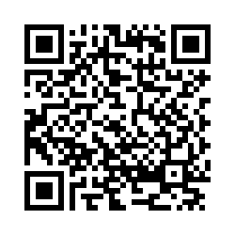
Navigating the Technology: How to “Ask your RSA state liaison”
Route 1
Route 2
Route 3
Turn on camera app
Frame the QR code
Click the pop-up
Weblink to the form
Request the hard copy form
https://sdsu.co1.qualtrics.com/jfe/form/SV_07LWvkjutLLoKsS
Hard copies of the form and instructions are available at the registration desk.

Slide 4
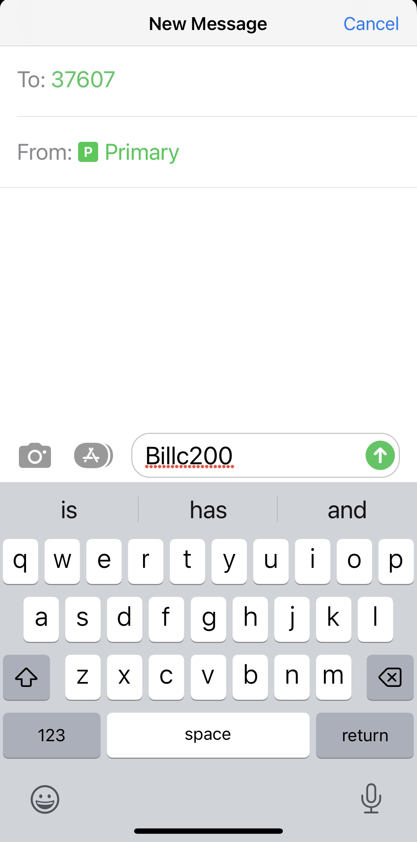
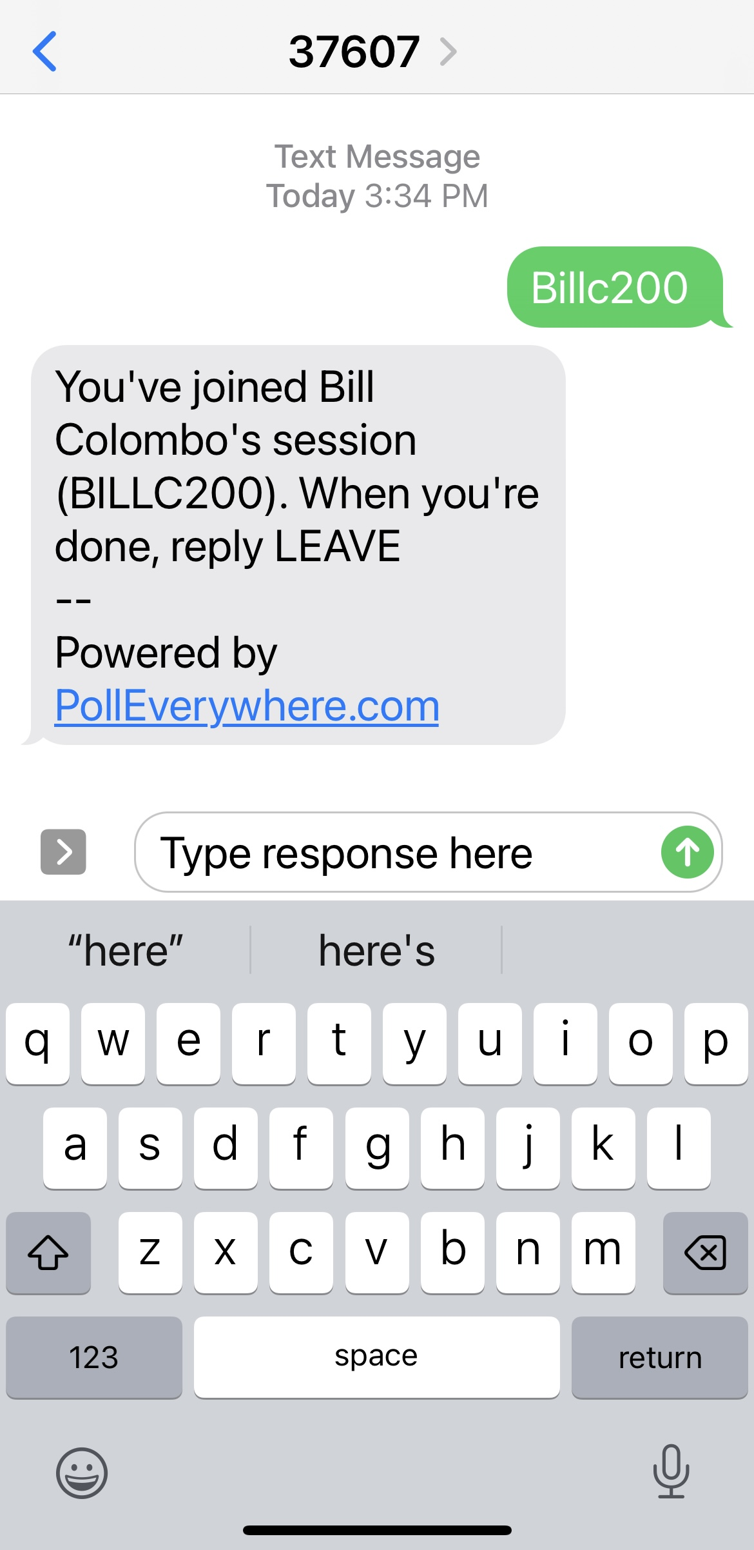
Navigating the Technology: How to respond to live polling questions*
Route 1
Screen 1
Screen 2
A. Text message #
Text
Messaging
B. Username
C. Type Response
To the text message number (37607)
Text the presenter’s username (Billc200)
Type your response
*Specific connection details will be provided when live polling is in use.

Slide 5
Notes:
Poll Title: Do not modify the notes in this section to avoid tampering with the Poll Everywhere activity. More info at polleverywhere.com/support Excluding the CSAVR conference, where is your #1 bucket list destination? https://www.polleverywhere.com/free_text_polls/fF5gItb7GjkqfNhtw29mF

Slide 6
Words from Our Federal Partners…
Katy Neas, OSERS Assistant Secretary
David Steele, Unit Chief-RSA Fiscal Unit

