Slide 1
Understanding Individuals with Autism Spectrum Conditions within Vocational Rehabilitation Services
Mary Baker-Ericzen, PhD
WINTAC
Interwork Institute, SDSU
Notes:
A bit about my background….A Clinical Psychologist and Research Scientist at the Interwork Institute in the Dept of Rehabilitation and Post-Secondary Education at SDSU. Experience working with the ASD population for 30 years. Conduct clinical work, services research using a research-community partnership with ASD individuals inside and outside my research programs. I have had a number of NIMH funded and foundation funded grants and more recently developed a series of Soft Skills program for ASD called employment SUCCESS, College SUCCESS and TAY SUCCESS. SUCCESS is an acronym which stands for Supported employment, Comprehensive Cognitive Enhancement and Social Skills.

Slide 2
Agenda
Overview of Autism Spectrum Conditions
Prevalence, Diagnosis, Causes, Attributes, Impacts
Understanding an Individual with ASD’s Profile including co-occurring conditions
Determining Functional Capacities in terms of work
Determining Primary Services for Individuals with ASD- matching services to profile
Initial Accommodations- To assist with gathering information to make determinations
Notes:
The objective with this seminar is provide an overview of Autism. Explain the population and ranges of needs. Help you all be more equipped at determining an individual with ASD functional capacities in terms of work and what primary services are likely need by matching to the individual person’s profile. I will also provide some initial suggestions of accommodations that will help you in gathering information and making determinations.

Slide 3
Autism Spectrum…..true spectrum
Autism Spectrum Disorders ARE a spectrum
Meaning: symptoms and characteristics of Autism/Aspergers can present themselves in a wide variety of combinations from mild to severe.
Children & Adults can exhibit ANY combination of the behaviors in ANY degree of severity
A group of symptoms with a range of similar features
No standard “TYPE” or “TYPICAL” individual with autism
Terms might hear: autistic-like, autistic tendencies, on the spectrum, high-functioning, low-functioning, more- abled, less- abled (specifying either end of spectrum)
Even spectrum of self-identification. Some prefer identity-first “autistic individual” over people-first “individual with autism” language.
Notes:
One of the first important factors of ASD is the “spectrum” notion. A common saying in ASD world is that “if you have met 1 person with autism; you have met 1 person with autism”. Be weary of generalizing from one to another, even more so than with other conditions. Take time to gather information and use multiple sources- written reports, self-reports, other informant reports AND observations

Slide 4
Agreed that
Autism is a spectrum disorder
ASD is a neurodevelopmental diagnosis that persists across lifespan
Expression of the disorder varies with age & developmental level
ASD has a biological/neurological etiology
ASD is an early development or retrospective diagnosis
Need a careful developmental history
ASD can co-exist with any other condition
Seizure Disorder
Intellectual Disability
ADHD
Anxiety/Depression
Schizophrenia
Genetic conditions (Landua-Kleffner Syndrome, William’s Syndrome, Fragile X)
Etc.
Notes:
There are still other terms used that refer to this population as autism, Asperger’s Syndrome, Pervasive Developmental Disorder, Non-verbal Learning Disability. What autism looks like for each person is somewhat unique and changes over time. Symptoms and functioning may increase or decrease over the lifespan. Other co-occurring conditions often increase over the lifespan and can negatively impact functioning and work capacity.
Seizures- start as teens/young adults 30%
ID- 30%
ADHD- 60-80%
Anxiety 40-60%
Depression 20-30% (adults)
Schizophrenia 5-35%
Sleep disorders ‘and gastrointestinal disorders 50%
Overweight- 30% Obesity 16%

Slide 5
Diagnosis
No Medical tests
No physical abnormalities
Diagnosed by the presence or absence of certain behaviors both by history and examination from trained professional (Psychologist, Psychiatrist, Physician, Educational Psychologist)
Notes:
An individual often will have a diagnosis already before entering VR. However, at times a referral for a diagnostic assessment is necessary because their written records don’t match well with reports and observations.
At this time there are no Medical tests- not even brain scans like MRI or PET scans or genetic testing can determine an ASD diagnosis
No physical abnormalities specific to ASD but the individual who does have these will have a co-occurring genetic condition or prenatal exposure to substances or toxins (known or unknown).
ASD is often considered a “hidden disability” due to the lack of physical signs
Psychologist need to have training and experience ASD as it involves interacting assessments to be able to observe presence and absence of behaviors along with reports from self and others.

Slide 6
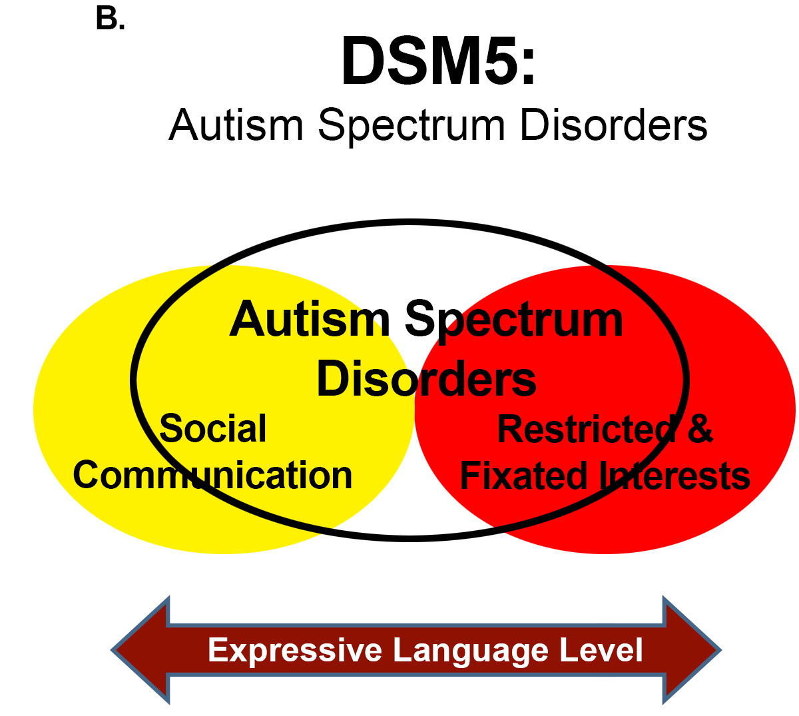
Autism Spectrum Conditions
1 in 59
1 in 37 males
Notes:
2018 Center for Disease Control statistics are 1 in 59 with 1 in 37 males; 4xs more often in boys. Kids can be reliably diagnosed by 2 yrs and there are assessment methods as young as 6 months. However, majority of children are still diagnosed after the age 4 and some into adulthood.
Autism effects all cultural and socioeconomic groups equally. However there are disparities in terms of service access and age of dx by race/ethnicity and SES.

Slide 7
Core AS Symptoms
Communication- especially Social Communication
Social Abilities – social cognitions and social skills
Restricted and repetitive cognitions and/or behaviors
Sensory input differences- hyper or hypo
Notes:
It is important to understand and gather individualized information on these core ASD symptoms that result in an ASD diagnosis as each is often an indicator of 1) functional competency and 2) primary service need.
Must meet criteria A, B, C,& D
A: persistent deficits in social communication and social interaction across contexts-manifest all 3
* Deficits in social-emotional reciprocity (conversations, play, social interactions)
* Deficits in nonverbal communication behaviors (display or interpretation)
* Deficits in developing and maintaining relationships appropriate developmentally (absence in interests to skill deficits)
B: restricted, repetitive patterns of behavior, interests or activities manifested in at least 2
*Stereotyped or repetitive speech, movements, or use of objects
*Excessive adherence to routines, rituals or resistance to change
*Highly restricted, fixated interests-abnormal intensity or focus
*Hyper or hypo reactivity to sensory input or unusual interests in sensory aspects
C: Symptoms must be present in early childhood but may not become fully manifested until social demands exceed limited capacities
D: symptoms together limit and impair everyday functioning

Slide 8
Other related symptoms
Executive functioning deficits (ADHD) (40-80%)
Intellectual Disability (ID) (~30%)
Non-verbal (but not non-communicative) (~30%)
Medical disorders (seizures ~25%, sleep disorders~50%)
Anxiety
Depression
Fine motor difficulties
Coordination challenges
Emotional regulation impairments
Unexpected/odd cognitions or behaviors
Notes:
31% of children with ASD have an intellectual disability (intelligence quotient [IQ] <70), 25% are in the borderline range (IQ 71–85), and 44% have IQ scores in the average to above average range (i.e., IQ >85).

Slide 9
What causes AS?
NO single cause known
Current research links to biological/ neurological differences in the brain
Enlarged head circumference
Brain structures: Cerebellum, Cerebrum, Amygdala
Brain matter: White & Gray ↑
Evidence for a genetic basis-multiple genes implicated
Chromosome 15q11, 7q, 2
Pathogens- Environmental
Heavy metals, Pylori, Proteins
Parental risk factors
Older parents
Prescription drugs valproic acid and thalidomide during pregnancy
NO Vaccine is causal to ASD!
Notes:
In sum, it’s Multi- faceted causes including bio and environmental factors.

Slide 10
Hallmark Behavioral Symptoms in Children which can continue into Adulthood
Disturbances in the rate of physical, social and language skills
Abnormal responses to sensations (any of 5)
Various ways of relating to people, objects and to events in the environment
Lack of motivation & initiative
Inconsistent development
Learned helplessness
Poor exploration, curiosity about environment or restricted to specific topics (then over exploration)
Aggression, tantrums
Notes:
Many developmental delays, hence the categorization as a developmental disorder
As mentioned sensory differences to any or all of 5 senses (tactile, visual, auditory, olfactory and taste).
May appear to pay more attention to objects than people; or limit attention to few pieces of context or certain details
More general lack of initiative and at times motivation. Current methods of expecting this population to call in and provide reports (number of jobs applied to) doesn’t work. Don’t respond to attending workshops via informational flyers provided.
Inconsistent with abilities too
Not able to “try” new jobs or “explore” what they like
Emotions can occur quickly and result in aggression or meltdowns but there is always reasons that can be discovered through functional assessment. Antecedent-Behavior-Consequence (ABC) assessment

Slide 11
Adult Autism Brain and Behaviors
Splintered skills
Literal, concrete and detail oriented
Lack of initiative and follow through (especially when met by challenge/barrier)
Learned to be compliant (ABA downfalls), which means wait for directives and lack of self-initiating
Lack of automatic “active thinking” and awareness (both environmental and self)
Slower processing speeds
Notes:
Few aspects to be observant of as these folks become adults which are more apparent then in childhood.
Skill variability and special talents
Passive involvement with world- wait for things to happen to them. Not active agents
Compliant doesn’t mean comprehension, overly imitative or prompt dependent
-Narrow focus in world around them and missing of much context including internal-self awareness and external- environmental/contextual awareness
- Overall slower processing speeds. On average response time to a question is 1-2 seconds. ASD population can range from 3-10 seconds. Very important to give time to respond.

Slide 12
Determining Autism Profile: Attributes
Attributes
Conscientious
Logical thinkers
Attentive to detail
Thrive on routine and stated expectations
Dependable- reliable
Support of social justice
Quality focused (perfectionist)
Strong splintered skills (Special Interests)
Memory abilities
Notes:
ASD folks have many positive attributes. Here is a list of common ones. It is important to have specific conversation and ask direct questions to gather information about each person’s attributes. Many of these are assets within a work environment but need to be explained how so to the individual. Too often the individual doesn’t see these as positive attributes and have too low of confidence to fully explain their abilities and assets. They especially don’t know how to apply these to be successful at work. Discussions need to be explicit and explanatory.

Slide 13
Famous Autistic Folks
Thomas Edison
George Orwell
William Butler Yeats
Winston Churchill
Wolfgang Mozart
L.S. Lowry
Andy Warhol
Daryl Hannah
Nikala Tesla
Chevy Chase
Jim Carey
Charles XII of Sweden
Tim Burton
Dan Aykroyd
Charles Darwin
Steve Jobs
Emily Dickinson
Albert Einstein
Sir Isaac Newton
Thomas Jefferson
Hans Christian Anderson
Lewis Carroll
Bill Gates (Microsoft)
Bobby Fischer
Satoshi Tajiri, (creator of Pokémon)
Jerry Seinfeld
In the words of Albert Einstein:
“My passionate sense of social justice and social responsibility has always contrasted oddly with my pronounced lack of need for direct contact with other human beings and human communities. I am truly a lone traveler and have never belonged to my country, my home, my friends, or even my immediate family, with my whole heart; in the face of all these ties, I have never lost a sense of distance and a need for solitude...”
Notes:
Did you know all of these? Do you know of others? Think locally and in your own communities.
Read albert Einsten’s quote carefully. Do you see reference to social justice? An attribute of his that he was not aware of as an important contribution to his own success. However, he does clearly understand his preference for distance from loved ones and limited affection.

Slide 14
Determining Autism Profile: Communication
Communication
Odd prosody; May be unusual quality of speech- lacking inflection, or rhythmic nature, formal/pedantic, too loud/soft, high/low pitch
Abnormal focus on a particular topic, providing much detail
Communicative reciprocity-one way conversations
Repetitive speech- perseverations
Poor articulation or stuttering (especially in new or less familiar environments)
Lack of question asking, or overuse (esp personal questions)-poor boundaries
Poor comprehension-irony, idioms, humor, sarcasm, clichés (interprets language literally)
Excessive or minimal talking
Limited use and understanding of gestures and non-verbals= contextual factors
Notes:
While gathering information in this domain use information from records, reports and OBSERVATION!
Take note how these may be related to capacity to work at the given time and which may require accommodations or explanations provided to employer. Level of communication and needs also can help an individual determine when to disclose their disability. People in community make too many assumptions based on a person’s observed communication.
Many people assume a limited verbal individual also has an intellectual disability. Use the “Assume Nothing; Obtain Explanations” approach instead!

Slide 15
Determining Autism Profile: Social
Social
Affections towards limited individuals
Low expressed empathy (but high internal empathy)
Low initiative
Below normal eye contact
May not seek comfort at times of distress- lower use of social supports
Limited emotional expression
Use isolation (and gaming/videos) to cope
Controlling or ritualistic in social interactions
Theory of Mind Deficits: Lack of understanding of social conventions, social cues and others’ perspectives
Exhausted by social interactions
Notes:
Again gather information in this domain using information from records, reports and OBSERVATION! Watch their body language carefully. Think about what your thinking of the individual when you observe it. That is how you can determine how it may be related to capacity to work at the given time.
What you think and feel while interacting with the person is going to be similar to what employer and co-workers will think and feel. If you feel uncomfortable so will they and a job placement won’t last. Consider Pre-Employment Services of Soft Skills training (preferably an intervention group over time and not a workshop type).

Slide 16
Determining Autism Profile: Restricted/Repetitive Behaviors or Interests
Restricted or Repetitive Behaviors or Interests
Restricted range of interests or preoccupations, perseverations (Also a strength), Obsessions
Strong attachment to a particular object or theme
Repetitive behaviors during stress or boredom: picking, pacing, self-talk, lining up objects.
High interest/need for routines and rituals (esp around daily living skills)
Sensory bound, sensory based behaviors
Notes:
Again with your observations notice your reactions. Are you bothered by such repetitive movements or can they be ignored? Can the individual limit them? Do they change as the person is more familiar or comfortable within the environment or with certain people? Do these behaviors serve as a calming technique for the individual and appear when stressed?
These types of questions help you determine impact on work capacity and need for services and/or accommodations.
Notice the large impact making sensory input adjustments can have for the individual. Be sure these are clearly noted and made in work places. Most sensory accmomodations are quite easy and low cost.

Slide 17
Determining Autism Profile: Cognitions
Cognitive
Splintered Cognitions
High and low abilities; Differences between processing visual vs auditory information
Executive Functions
Problems with organization, planning, controlling impulses, understanding abstract concepts, retaining information in working memory, managing time and prioritizing
Central Coherence
Difficulty understanding context and “see the big picture”
Notes:
Prior test records and school IEP records can be very useful for understanding a person’s cognitions. These, overall, are harder to observe when not spending long periods of time with the individual in their daily life.
Look for executive functioning challenges. Gather information from other informants along with self-report forms. Behavior Rating Inventory of Executive Functioning0 adult form (BRIEF- A) is great measure to use. Also a teen version.
As many have difficulty with central coherence, “seeing the big picture” they are likely not understanding the point of your meetings or what the IPE is about or why certain services. All of these should be explained. Again, be careful about assuming the individual understands but rather they don’t and take the time to explain.

Slide 18
Determining Autism Profile: Sensory and Emotions
Sensory Sensitivities and Emotional Reactions
Atypical processing of sensory input
Despite normal hearing, vision etc.
Can include hypersensitivity &/or hypo sensitivity to various sensations in the same individual
Slower auditory processing
Easily over-stimulated
Increased sensory reactions in times of stress
Notes:
These sensory reactions can be difficult to understand as each can be specifically tied to the environment.
For example, Person shies away from being touched but likes to wrestle as their hobby.
Person doesn’t seem to hear verbal instructions but is oversensitive to sound of the copy machine. Person wears a strong cologne but says the smells in the break room disturb him greatly.
Remember when I said this population often takes 3-10 seconds to respond. Experience it. I will ask myself a question and then answer it. I will do it 3 times. Try to guess the processing time. Feel what it’s like to wait for the answer. Did everyone feel that it was painful to wait 10 seconds for a response? It is! Be sure to count to yourself. It is the only way to stop that painful experience.
If you ask the question again, rephrase it or change the topic before the person responds the individual needs to start the processing sequence all over again. It is like when your computer is taking a while to boot up and you press keys. It starts over and eventually overworks the processer to the point of either freezing or overheating. So does the ASD brain. It either freezes or blows up (emotionally speaking).
Sensory overloads can also lead to these reactions- freezing/shutting down or emotionally reacting.

Slide 19
Determining Autism Profile: Co-occurring
Co-Morbidity
70-90% of adults with autism have at least one additional disorder:
ADHD- Inattention, Hyperactivity, combined
Anxiety: social anxiety, generalized anxiety, specific fears/phobias, OCD
Depression: Major depression disorder, bipolar disorder
Schizophrenia- schizotypal, Delusional
Tourette’s syndrome, tics
Sleep Disorders: Insomnia, sleep apnea
Notes:
Very common!
Again look at records, reports and OBSERVE! Unfortunately many of these are un or under-diagnosed and therefore un or under addressed.
These often lead to negative impacts on work capacity- maybe even more so than autism related symptoms.
Frequently observe challenge in work place related to ADHD, Anxiety, Depression and Sleep! Regular attendance problems due to these or falling asleep at the worksite doesn’t go over well with employers.

Slide 20
Individual’s Profile- Endpoint
Diagnoses
Current functional level
Consider these Functional Capacities:
Mobility (transportation to and from worksite)
Communication (process communication, inappropriate communications, focus/concentration & understanding)
Self-Care (hygiene and eating; money management)
Self-Direction (taking initiative, staying on task, task completion)
Interpersonal Skills (interact in socially acceptable manner, respond to feedback, appropriate work behaviors, interacts with others)
Work Tolerance (sensory issues, accommodations, sustained attention)
Work Skills (processing information, memory use)
Preferred modality of learning (visual images, verbal, written, experiential)
Interests
Talents –areas of strength
Sensory needs
List of accommodations
Activity Idea: Individual makes a “shield of arms” or “personal homepage” which indicates these at start of VR or IPE
Notes:
Now, put all of these together to formulate a profile .
Indicate specifically how these each relate to capacity to work- both in the positive and negative sense.
Create list of initial- immediate accommodations- those even needed to continue through eligibility process or to benefit from primary services.
Then your ready to start to determine primary services

Slide 21
Autism In Adulthood
Over the next decade, an estimated 500,000 teens (50,000 each year) will enter adulthood and age out of school based autism services.
Teens with autism receive healthcare transition services half as often as those with other special healthcare needs. Young people whose autism is coupled with associated medical problems are even less likely to receive transition support.
Many young adults with autism do not receive any healthcare for years after they stop seeing a pediatrician.
More than half of young adults with autism remain unemployed and unenrolled in higher education in the two years after high school. This is a lower rate than that of young adults in other disability categories, including learning disabilities, intellectual disability or other mental health conditions.
Of the nearly 18,000 people with autism who used state-funded vocational rehabilitation programs in 2014, only 60 percent left the program with a job. Of these working, 80 percent worked part-time at a median weekly rate of $160, putting them well below the poverty level.
Nearly half of 25-year-olds with autism have never held a paying job.
Research demonstrates that job activities 1) encourage independence 2) reduce autism symptoms and 3) increase daily living skills.
Information provided by Autism Speaks https://www.autismspeaks.org/autism-facts-and-figures
Notes:
Here is good information from Autism Speaks
Many are calling these large number of youth with autism transitioning to adults the “adult autism services tsunami” . Increases in autism population in the VR system have only just begun.
Also notice the reference to the lack of successful transitioning into adult service sectors. This is being referred to as the service cliff. Many transition age youth are dropping off the grid when aging out of child system. They are not transitioning into primary care with new medical home. Not accessing VR services and obtaining employment. No longer receiving supports focusing on skill based learning like specialized education, speech therapy, occupational therapy, counseling etc.
Not the successful life outcomes desired and deserved.

Slide 22
Economic Impact of Autism
The cost of caring for Americans with autism had reached $268 billion in 2015 and would rise to $461 billion by 2025 in the absence of more-effective interventions and support across the life span.
The majority of autism’s costs in the U.S. are for adult services – an estimated $175 to $196 billion a year, compared to $61 to $66 billion a year for children.
On average, medical expenditures for children and adolescents with ASD were 4.1 to 6.2 times greater than for those without autism.
Passage of the 2014 Achieving a Better Life Experience (ABLE) Act allows tax-preferred savings accounts for people with disabilities, including autism, to be established by states.
Passage of autism insurance legislation in 48 states is providing access to medical treatment and therapies.
Information provided by Autism Speaks https://www.autismspeaks.org/autism-facts-and-figures
Notes:
More interesting information from Autism Speaks
Many seem to think that the children are receiving all the services however, the cost of adult services are substantially more. How? Well remember people are children for 18 years (now a days 22 yrs, 25 or 26 in some settings). Average life span in America is currently to 79 years. That is leaving between 53-61 years as an adult!
That is a LOT of time available to learn new skills- job skills, vocational soft skills, independent skills yet are adult services are not focusing on skill development often enough.
Let’s keep the momentum going for skill building services, for job training and competitive employment and natural supports building capacities within communities. All of these folks have the time to learn and DO!

Slide 23
Determining Primary Services- Linked to Profile
Assessment
Counseling and guidance
Pre-Employment Transition Services or Pre-Employment Training
Teaching specific job skills
Teaching global professional skills
Teaching vocational soft skills
Teaching mobility- transportation
Teaching Independence
Medical Treatment
Post-Secondary Education
Vocational Training
Job Development- including customized employment- Job Search
Job Placement- Job Coaching, Support Employment
ADULTING: Support but don’t save!
Notes:
OK. Now start to think about the autistic individual’s profile and link to primary services.
Do the records of diagnoses match your observations? If not consider assessment services
Does the individual have some understanding of career goals or interests? Is the person able to self- report? If not consider counseling and guidance services
How is the person’s communication and social skills (vocational soft skills)? If not so good consider Pre-Employment Vocational Soft Skills Training
How old is the individual? Are they transitioning into VR system? If yes then Pre-Employment Transition Services to focus on one or more specific job related skills
Are there a number of medical issues and the person is without a medical home? Consider medical treatment services
Does the person have some career goals based on their special interests but lacks some specific knowledge or job skills? Consider post-secondary education or vocational training
Is the person skilled but hasn’t successfully obtained or maintained a job? Consider Job search, job development services
Is the person ready to work and has clarity on what they want to do but lacks experience and confidence? Consider job placement, job coaching and/or supported employment.

Slide 24
So What Do YOU Do Right Away?- Initial Accommodations
Understanding of individual’s profile- interpreting verbals and nonverbals
Given options and Modeling of Goal-oriented thinking and planning
Structure and Schedules for meetings and services
Multimodal Information (visual, auditory, written, experiential/practice)
Priming
Direct Instruction and demonstration
Sensory accommodations
Graded Exposure- sequentially expecting more as more familiar with environment and people
Time to response
Notes:
Here are some likely “in the moment” accommodations to make while working with ASD consumer. All of these are things you can do right away, today!
Observe more carefully and integrate information into formulating an individual profile of each consumer with ASD
Don’t expect the individual to name what they want. Use leading inquiry. Give options to choose from. Model and draw out how to think about a job goal or career. Write out planning steps with the individual.
Provide structure in all meetings and clearly schedule meetings. Send meeting reminders. Use agendas. Provide in writing and in advance
Provide all information in more than 1 format- verbally, written, visually with pictures/images/icons and experientially be role-playing or demonstrating
Introduce concept/information prior to explaining. Inform what will occur in advance. Provide information to read/look at in advance
Use direct questions and instructions. Make to do lists with them. Demonstrate How to do something
Provide sensory accommodations- remove hand shaking or eye contact, reduce lights or turn off sounds, close windows etc
Have multiple meetings of shorter time periods as graded exposures- allowing time to become familiar with you and environment
Provide up to 10 seconds to response. Count to yourself while you wait.

Slide 25
Coming SOON!!
Autism focused series of trainings to help VR counselors work with individuals with autism through all phases of the rehabilitation process.
Topics Include:
Engaging and Communicating with Individuals with Autism before, during and after Enrollment Process- Eligibility Determination
Tailoring assessments and Individualized Plan for Employment (IPE) process for Consumers with Autism
Interventions, Services, Supports and Accommodations for Individuals with Autism to enhance Competitive Integrated Employment (CIE) outcomes

Slide 26
The End
THANK YOU!!!!
mbakerericzen@sdsu.edu

