Slide 1
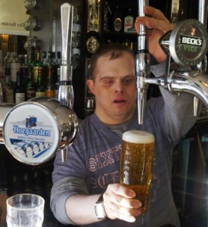
An Outsider’s Explanation of Supported Employment
Laurie Ford
Center for Continuing Education in Rehabilitation
University of Washington
http://www.orchardhill.ac.uk/supported-employment/
Notes:
Why an outsider?
Not from Louisiana, for sure
Worked WITH VR for many years, but not for VR
On the other hand – involved with SE for both people with DD and people with MH disabilities for over 30 years
Not going to talk about specific LA policies and systems – Melissa and Jeanne will be covering those in the face to face training
Why this picture? We often think of SE as just janitorial, stocking etc. but it really can involve any kind of work so I liked this atypical photo.

Slide 2
Who is this person?
Former
Job developer
Job coach
SE Program manager
Educator/trainer
RRCEP/TACE director
And most importantly…

Slide 3
Finna’s Grammy ☺

Slide 4
What does the law say?
(38) SUPPORTED EMPLOYMENT. – The term “supported employment” means competitive integrated employment, including customized employment [or employment in an integrated work setting in which individuals are working on a short-term basis toward competitive integrated employment] that is individualized and customized consistent with the strengths, abilities, interests and informed choice of the individuals involved, for individuals with the most significant disabilities –
Notes:
This is what WIOA says
Workforce Opportunity and Innovation Act of 2014

Slide 5
WIOA Part Two
(A) (i) for whom competitive integrated employment has not historically occurred; or (ii) for whom competitive integrated employment has been interrupted or intermittent as a result of a significant disability; and
(B) who, because of the nature and severity of their disability, need intensive supported employment services and extended services after the transition described in paragraph (13) (C), in order to perform the work involved.
Notes:
This is what WIOA says
Workforce Opportunity and Innovation Act of 2014

Slide 6
Let’s take a closer look
competitive integrated employment
Notes:
So many important words here!
Competitive – jobs that are open to others in the community
Integrated – working with individuals with and without disabilities, beyond those who are paid to provide services.
This can include customized employment, or employment in an integrated work setting in which individuals are working on a short-term basis toward competitive integrated employment
,

Slide 7
Let’s take a closer look
competitive integrated employment
that is individualized and customized
Notes:
Individualized and customized – not just one size fits all

Slide 8
Let’s take a closer look
competitive integrated employment
that is individualized and customized
consistent with the strengths, abilities, interests and informed choice of the individuals involved
Notes:
Consistent with strengths, abilities, interests, informed choice – individualized services, not an automatic referral to the local sheltered workshop or whatever.
,

Slide 9
For individuals with the most significant disabilities
For whom competitive integrated employment has not historically occurred; or has been interrupted or intermittent as a result of a significant disability; and
Notes:
Does that mean has not historically occurred for a specific individual? No, for individuals like that.
Interrupted or intermittent – think about folks with disabilities like bipolar

Slide 10
For individuals with the most significant disabilities
For whom competitive integrated employment has not historically occurred; or has been interrupted or intermittent as a result of a significant disability; and
Who, because of the nature and severity of their disability, need intensive supported employment services and extended services
Notes:
Notice that it’s not a specific diagnosis or condition that’s specified – it’s all about the need for support due to the nature and severity of disability. Think about it – if you have a physical disability (use Mark Fristo as example), once the physical accommodations are made, the person can compete on a level plain with employees without disabilities. If you have something like mental illness, intellectual disability, or traumatic brain injury, your disability may pose challenges on the job for as long as you’re working – dealing with changes on the job, new supervisors or tasks, changes in health or personal life, transportation, housing – just about anything can upset the balance that’s established.
To some degree, the need for SE is a judgment call, and your information may be limited. Some people obviously need it; others end up there after being unsuccessful trying independent employment.

Slide 11
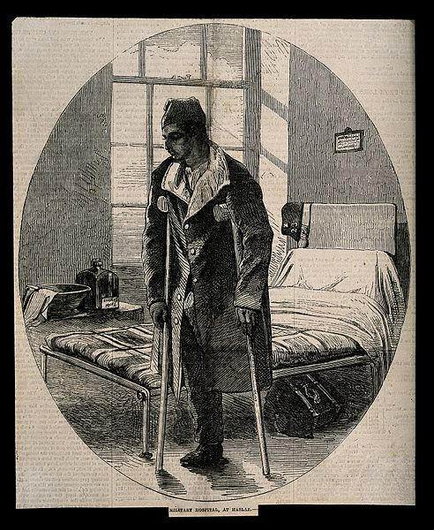
Where did it come from?
Original VR program was developed first for veterans, then for civilians with physical disabilities. Hence the model – intensive, short term, “rehabilitative” services
Notes:
Why during WW I? People were surviving, couldn’t return to farming and manufacturing jobs

Slide 12
The “emotionally disturbed, and mentally retarded” (sic) were added to VR services in 1943 – but the model didn’t work very well for many people with the most significant disabilities.
Notes:
The result was that most people with ID/DD etc. weren’t served by VR – they weren’t seen as “feasible”

Slide 13
The “emotionally disturbed, and mentally retarded” (sic) were added to VR services in 1943 – but the model didn’t work very well for many people with the most significant disabilities.
“Place and pray” – drop ‘em off at the job and pray that all goes well!
Notes:
The result was that most people with ID/DD etc. weren’t served by VR – they weren’t seen as “feasible”

Slide 14
People with MSD had limited options before the end of the 1970’s
Notes:
If you were DD/ID and had some work capability, you would probably be referred to a sheltered workshop. That was considered a GOOD outcome –otherwise, you’d be sent to a work activity center. Very few people received the services they needed to be successful in competitive employment. In general, people were served by EITHER VR OR DD – not both.

Slide 15
Three forces combined in the late 1970’s and early 1980’s to blow up our assumptions about employment for people with significant disabilities:

Slide 16
Power instruction based on behavioral principles (e.g. Marc Gold and Try Another Way)
Notes:
Let’s take a quick look at each of these, starting with Marc Gold

Slide 17
Power instruction based on behavioral principles (e.g. Marc Gold and Try Another Way)
Integrated education under PL 94-142
Notes:
Let’s take a quick look at each of these, starting with Marc Gold

Slide 18
Power instruction based on behavioral principles (e.g. Marc Gold and Try Another Way)
Integrated education under PL 94-142
University-based demonstration projects
Notes:
Let’s take a quick look at each of these, starting with Marc Gold

Slide 19
"For a century now, those of us working with the retarded have described their limitations. We worked with the retarded, operating with these expectancies and ‘proved' we were right. Sure enough, they did only as much as we said they would. We taught our successors these limiting expectancies, and they in turn proved that we were right. And the cycle goes on." Marc W. Gold; April 1973
Notes:
POLL – HOW MANY OF YOU HAVE HEARD OF MARC GOLD?
Dr. Gold helped us see that our low expectations were one of the causes of poor outcomes. Through his application of behavioral principles to structured teaching methods, he was able to teach people with very significant ID how to do very complex tasks.

Slide 20
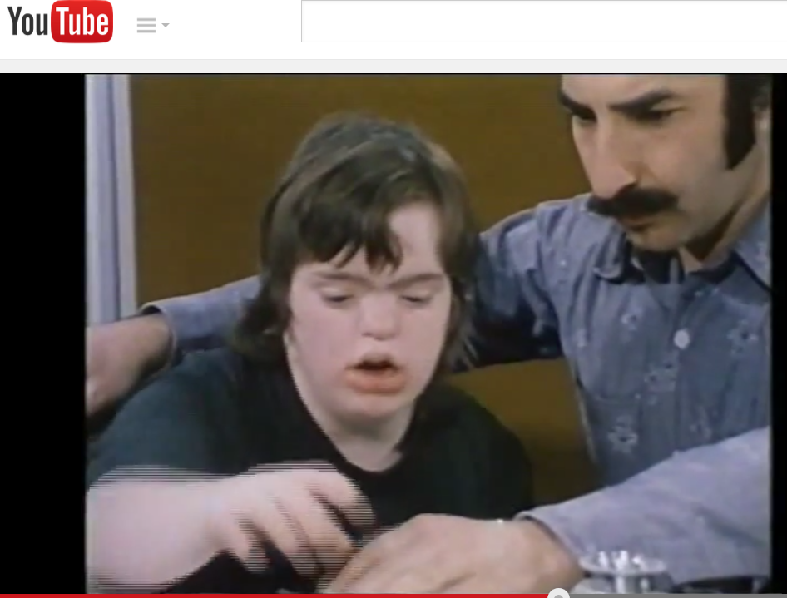
https://www.youtube.com/watch?v=u-zeVeY2zYY

Slide 21
94-142: Education for All
The Education for All Handicapped Children Act was enacted by the United States Congress in 1975. This act required all public schools accepting federal funds to provide equal access to education and one free meal a day for children with physical and mental disabilities.
Notes:
Second influence – integrated education. There were no kids with significant disabilities in my high school in 1968 when I graduated – no one in a wheelchair, no one with a service dog or white cane, no one with a sign language interpreter, and certainly no one with intellectual or developmental disabilities. None. 94-142 required that school districts begin to provide equal access to education in the least restrictive environment – of course, we’re still struggling to make that work for all students, but at least we buy into the value behind the law. What happened when kids with SD started to graduate from integrated school settings? Increasing numbers of families said, “what do you mean Joey is going to a sheltered workshop? Why should he be segregated now?”

Slide 22
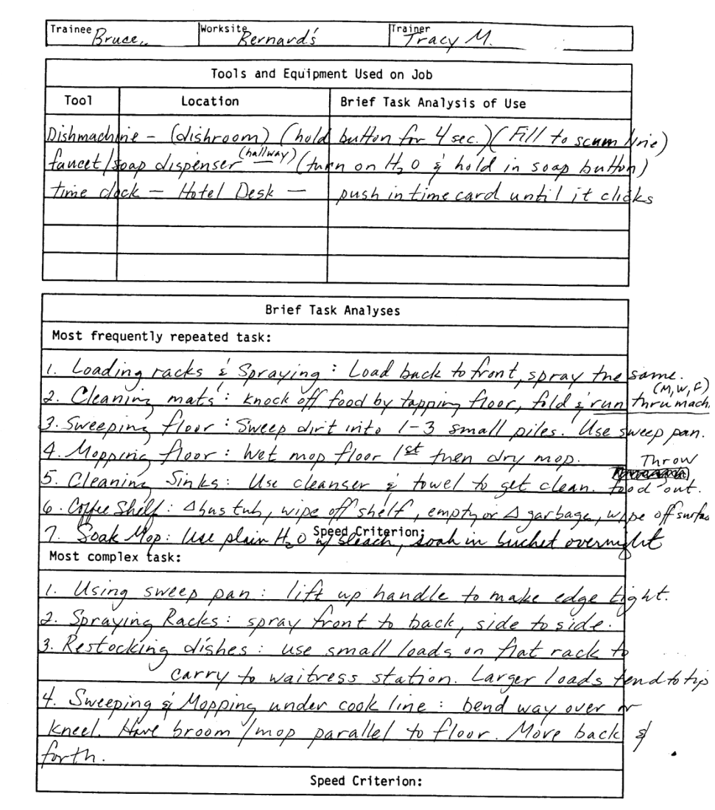
University-based Demonstration Projects
Notes:
Early programs in places like Virginia Commonwealth University, the University of Oregon, and the UW (which is where I got my start) experimented with helping people with SD train for and access jobs in the community, blending funds from VR and DD. Many of these were individuals who were coming from sheltered workshops; some of the people we worked with stayed in food service jobs for 25+ years.
Success in helping people access jobs led to the realization that many people continued to need support in order to maintain employment as well as to access it. One strength of these university-based projects is that we all collected a lot of data – we could show our funding partners just how long people stayed in jobs, how often they needed to get new jobs, and how many hours of service we were providing in order to help people stay employed. This helped pave the way for funding of ongoing supports.

Slide 23
The mid-1980’s brought legislative and system changes
Supported employment definition and funding were added to the Rehabilitation Act
OSERS funded state system change projects over several years
More recently Medicaid waiver funding, research on best practices in serving individuals with mental health disabilities, and Employment First efforts have brought even more SE eligible individuals into VR services
Notes:
RSA built an added incentive for state VR agencies to jump into supported employment – no state match requirement
Since then, of course, the number of VR participants with DD/ID and MH disabilities has grown tremendously

Slide 24
What does Supported Employment look like?
Generally individual jobs in the local community
Sometimes group employment (i.e. crews, enclaves)
Occasionally, help in starting a business
Notes:
Project search?

Slide 25
It’s all about the
Match!
Notes:
No matter how capable you are, if you’re not in the right job you’re not going to be happy.

Slide 26
Meet Pam
Notes:
This is a picture of Pam and her boss at her retirement party after working at Pagliacci Pizza in Seattle for 25 years. She is one of the first people I helped get a job. When she started with our program, she had finished school but had no work experience. It took us a while to find the right fit for her – I think this was the fourth placement we tried. The services we provided included:
Job development – contacting and exploring potential employers on her behalf
Job modification and accommodation
Skill development – both vocational and social
Coordinating communication between her family and her employer
Reintervention when her supervisor changed

Slide 27
and Lester
Notes:
OK, Pam was an easy one in some ways – she had many disability limitations, but good family support, a good work ethic, and a nice personality. Lester was a bit more challenging. I don’t have a picture of him but I wanted to include him because he presented some different challenges than Pam.
Lester’s disability involved mental health – he had a thought disorder that caused him to have difficulty processing information and also to behave in some unusual ways. We were finally successful in finding him a job in a school district book warehouse. There was some interesting negotiations that had to happen with the supervisor – Lester’s delusions required him to sprinkle baking soda across the thresholds of the warehouse every morning “to keep the devils out.” We were able to negotiate this accommodation, as long as he vacuumed it up at the end of his work day.
The kind of services we provided for Lester included:
Job development and also support for him visiting potential workplaces to assess his comfort
Lots of training and reassurance for the supervisor
Negotiating accommodations like written job assignments (as well as the white powder)
After Lester had been working for a while, he became too ill to work for a few weeks – we worked with the employer to coordinate his return to work and to provide a brief period of retraining and extra support.

Slide 28
What does “support” mean?
Notes:
The law doesn’t give us much structure here – remember, services are supposed to be individualized? Every individual and every job situation are different – one person might benefit from lots of intensive support on the job, another might not need any assistance to start working, but need some help dealing with challenges that arise after she’s been on the job for a while.

Slide 29
Job coaching is most common
Structuring the job, building in cues and feedback, teaching skills, troubleshooting, modeling appropriate behavior
Can also be provided away from the job
Hope your job coaches don’t look like this!
Notes:
POLL – HAVE ANY OF YOU EVER DONE JOB COACHING?

Slide 30
Other typical activities:
Consulting with the employer & coworkers
Helping with social integration on the job
Transportation arrangements
Coordinating services (e.g. residential, medical, etc.)
Connecting with other resources
Etc. etc. etc.
Notes:
There is a lot of variability based on the needs of the employee, what other resources are available, the demands of the job, and so on. Good supported employment providers know how to help in a lot of different ways.
Eric story

Slide 31
Who pays?
Notes:
The $64,000 question! How do we braid – not blend – available funding so that people get the support they need to get employed and stay employed?
Let’s look at the flow.

Slide 32
Part 1: Eligibility and Planning | Part 2: Placement, Training and Support | Part 3: Extended Services
VR provides counseling and guidance, arranges for assessment, develops plan | VR oversees authorized services, tracks achievement of plan | VR closes case (usually after 90 days)
Paid for by VR | Paid for by VR | Paid for through Medicaid Waiver or state $$ by DD or Mental Health
CRP might be involved in assessment to help plan development | Services usually provided by a CRP, MH Center, etc. | Services usually provided by CRP, MH Center, etc.
Source for extended services should be identified as part of plan | Services typically provided on the job, but sometimes not | Sometimes natural supports, family supports or WRAP plans can be used instead of paid services
 | Time limited | Not time limited
Notes:
Let’s take a closer look at placement, training/support, and extended services

Slide 33
Part 1: Eligibility and Planning | Part 2: Placement, Training and Support | Part 3: Extended Services
VR provides counseling and guidance, arranges for assessment, develops plan | VR oversees authorized services, tracks achievement of plan | VR closes case (usually after 90 days)
Paid for by VR | Paid for by VR | Paid for through Medicaid Waiver or state $$ by DD or Mental Health
CRP might be involved in assessment to help plan development | Services usually provided by a CRP, MH Center, etc. | Services usually provided by CRP, MH Center, etc.
Source for extended services should be identified as part of plan | Services typically provided on the job, but sometimes not | Sometimes natural supports, family supports or WRAP plans can be used instead of paid services
 | Time limited | Not time limited
Notes:
Let’s take a closer look at placement, training/support, and extended services

Slide 34
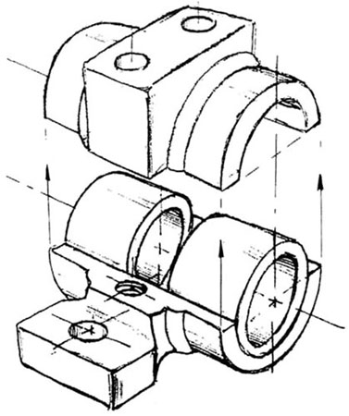
Part 2: Time Limited Services (typically paid for by VR, often provided by CRP)
Identifying work goal and support needs
Secure and stabilize competitive job
Develop productivity acceptable to employer
Support adjustment to workplace and culture
Develop coworker and community supports
Notes:
Obviously, not everyone is going to need all these services. Some people may be able to find their own job; others may need lots and lots of help. I remember working with a young lady who was sure she wanted to work with cows…
Some people like Pam don’t need much help adjusting to the workplace culture and developing relationships with others on the job, while in other cases there may need to be a lot of modeling, skill development, and educating others in the workplace
The new law – WIOA – states that this time period where VR is providing services should not extend beyond 24 months “except that period may be extended, if necessary, in order to achieve the employment outcome.”

Slide 35
Part 3: Extended Services (typically paid for by Medicaid waivers or state funds)
Helping the person stay employed through support, retraining, whatever
Career advancement
Supporting job changes if appropriate
Changing support plan over time as needed
Notes:
This is the part that needs to be included in the IPE – the person NEEDS support, so where it is going to come from?
Most often DD or MH provides ongoing support services using Medicaid waiver $$ or state funds.
Other possibilities – natural supports. Private pay. WRAP.

Slide 36
Indicators of Quality
Always looking for…
Hiring by the business
Supervised like other coworkers
Paid comparable wage and benefits
Integrated
Social access to coworkers
And also
Consistent with worker’s preferences
Maximizing work hours and earnings (while honoring preferences)
Opportunities for advancement

Slide 37
Indicators of Quality
Always looking for…
Hiring by the business
Supervised like other coworkers
Paid comparable wage and benefits
Integrated
Social access to coworkers
And also
Consistent with worker’s preferences
Maximizing work hours and earnings (while honoring preferences)
Opportunities for advancement
Bottom line – is this a job you would want for yourself, or for one of your kids?

